Slide 1
Sketching with Hardware
01: Introduction & Overview

Slide 2
What are we doing here?

Slide 3
Combine the features of physical objects and actions with digital data and algorithms

Slide 4
Tangible User Interfaces
A tangible user interface (TUI) is a user interface in which a person interacts with digital information through the physical environment.
- Wikipedia

Slide 5
What is a TUI?
UI that can be manipulated physically
State of pysical artifact and digital data are linked
Real world information (like position) as parameters

Slide 6



Hiroshi Ishii (MIT) on TUIs
Physical
World
https://www.makingthings.io/tangible-bits-and-radical-atoms/
Digital
World
A graphical user interface
only lets us see information
and interact with it indirectly, as if we were
looking through the surface
of the water to interact with
the forms below.
A tangible user interface is like an iceberg: there is a portion of the digital that emerges beyond the surface of the water - into the physical realm - so that we may interact directly with it.
Radical Atoms describes our vision for the future of interaction, in which all digital information has physical manifestation so that we can interact directly with it - as if the iceberg had
risen from the depths to reveal its sunken mass.

Slide 7
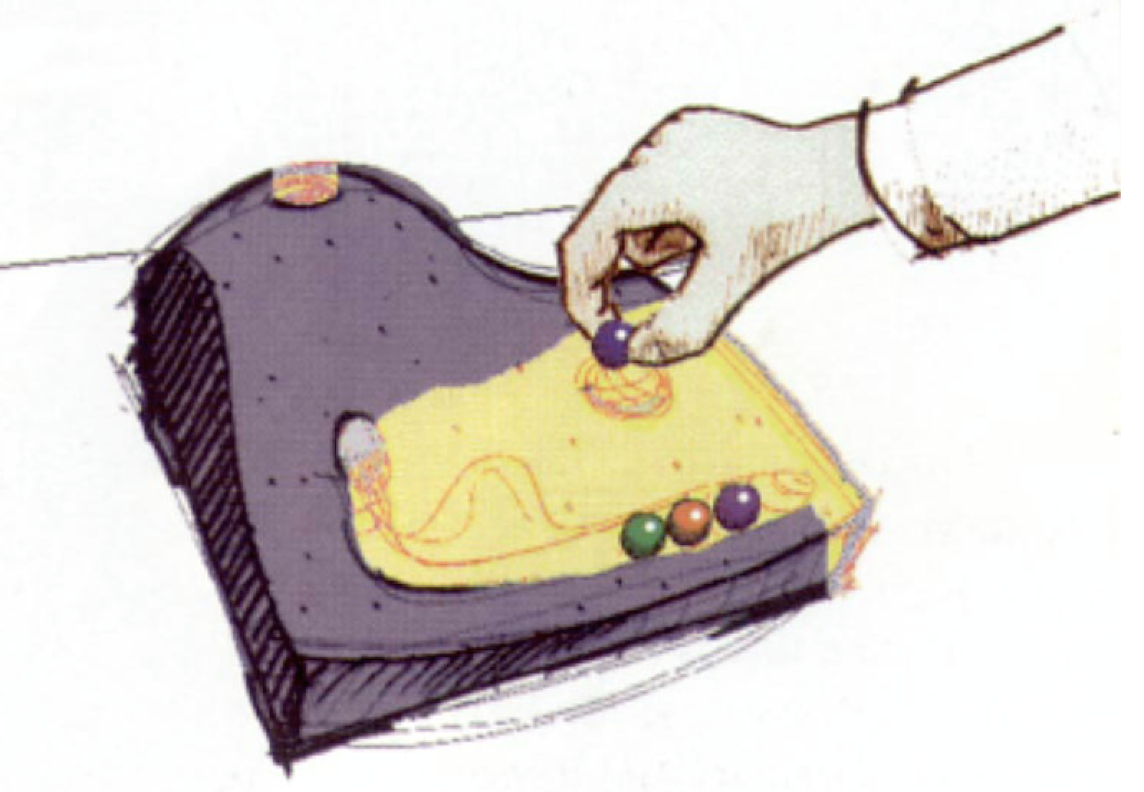
Marble Answering Machine (Bishop, 1992)
https://www.youtube.com/watch?v=RgVbXV1krgU

Slide 8
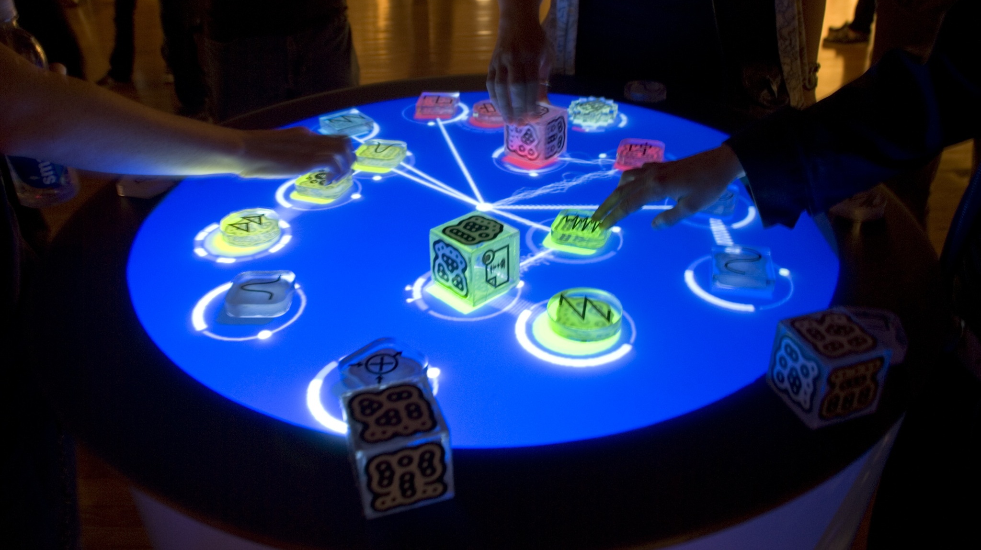
Reactable (Jordà et al, 2010)
https://www.youtube.com/watch?v=ltjQJz2uz2E

Slide 9
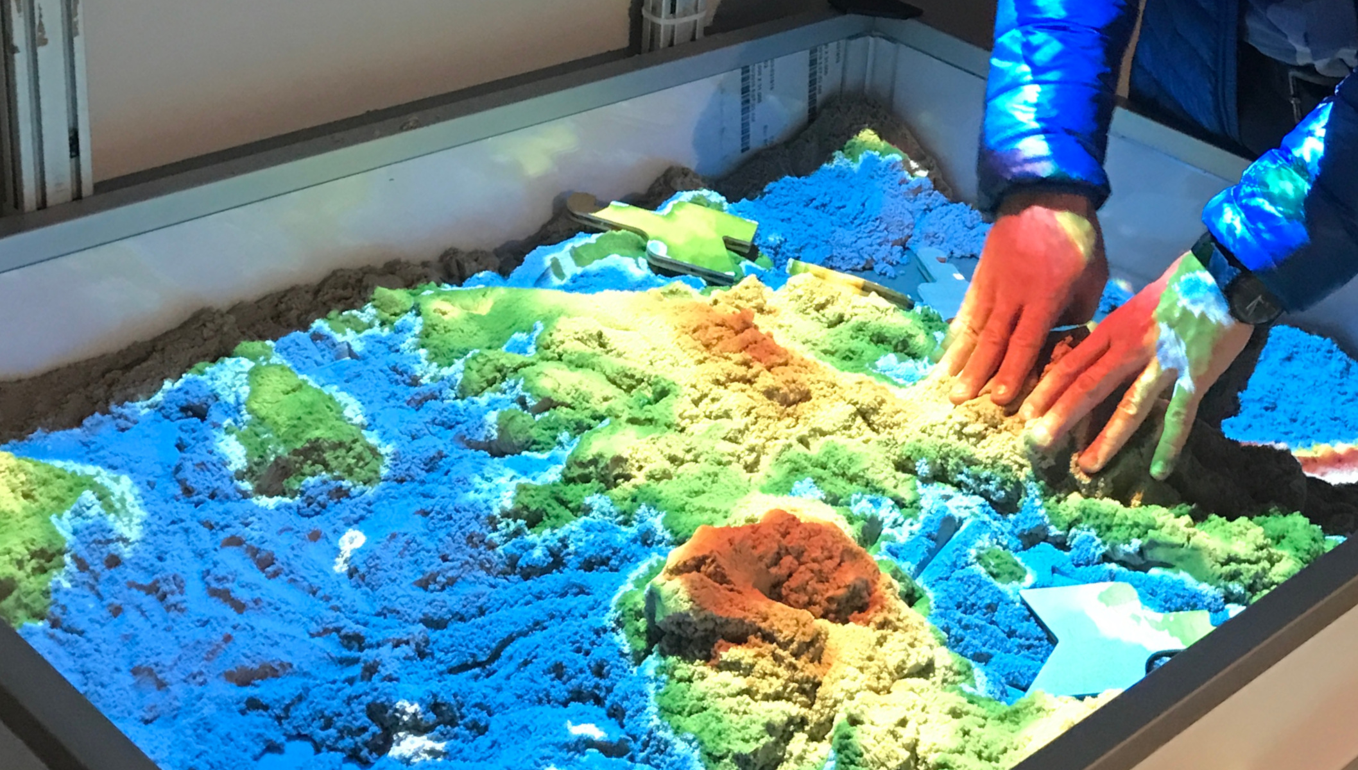
SandScape (Wang et al, 2003)
https://www.youtube.com/watch?v=XpyJcN3Tyzg

Slide 10
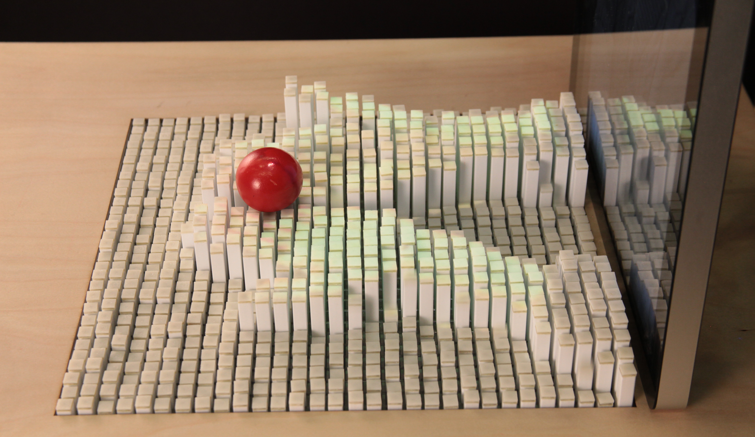
InForm (Leithinger et al, 2013)
https://www.youtube.com/watch?v=lvtfD_rJ2hE
© 2012 Tangible Media Group / MIT Media Lab

Slide 11
What are we doing here?
Building interactive, tangible, intuitive experiences
Basics of electronics
Basics of microcontrollers
Designing physical user interfaces

Slide 12
Timetable

Slide 13
Monday
Tuesday
Wednesday
Thursday
Introduction
Electronics
Soldering
Arduino
Programming
Serial Protocols
Sensors & Actors
Interaction Design
Brainstorming
Topic!
Friday to Thursday: Final Project
Friday
until xx.yy.
Implementation
Testing
Documentation
Thursday: Presentation
Bugfixing
Polishing
Cleaning up ;)
Final Assignment:
Project Video
Documentation
Finished Prototype

Slide 14
Day 1: Monday, xx.yy.
09:00 Introduction
10:00 Electronics 01, Multimeter
12:00 Lunch Break
13:00 Soldering
15:00 Electronics 02
17:00 End

Slide 15
Who are you?
What’s your name?
Why did you apply for this course?
What’s your experience with electronics?

Slide 16
After this course, you can...
...repair a broken bicycle light
...build a pet robot
...build an alarm clock that wakes you up with an electrical shock
...build a custom game controller
...estimate the cost and workload of developing electronic gadgets
...write a thesis with an interesting topic

Slide 17
Choice of Partners
Random!
Only for today
New partners each day (Mon, Tue, Wed)

Slide 18
Task: A machine the world needs
Invent machines that should exist
Example: “A device that automatically locks the door when I want to concentrate.”
Do not think about the technical implementation!
Time: 10 minutes

Slide 19
Tips and Rules for the Course
Take notes!
Take care of material and other participants
Work in groups
Be present
Ask questions
Continuously document your progress

Slide 20
Safety Instructions
Mind the lab rules
Fire extinguisher and first aid kit
No open drinks or food at the workplace
Ask before you use tools
Ask before you power a circuit
No experiments with AC power
Keep your workplace tidy
In case of severe or repeated violation: Exclusion from the course!

Slide 21
What’s in the Box?

Slide 22
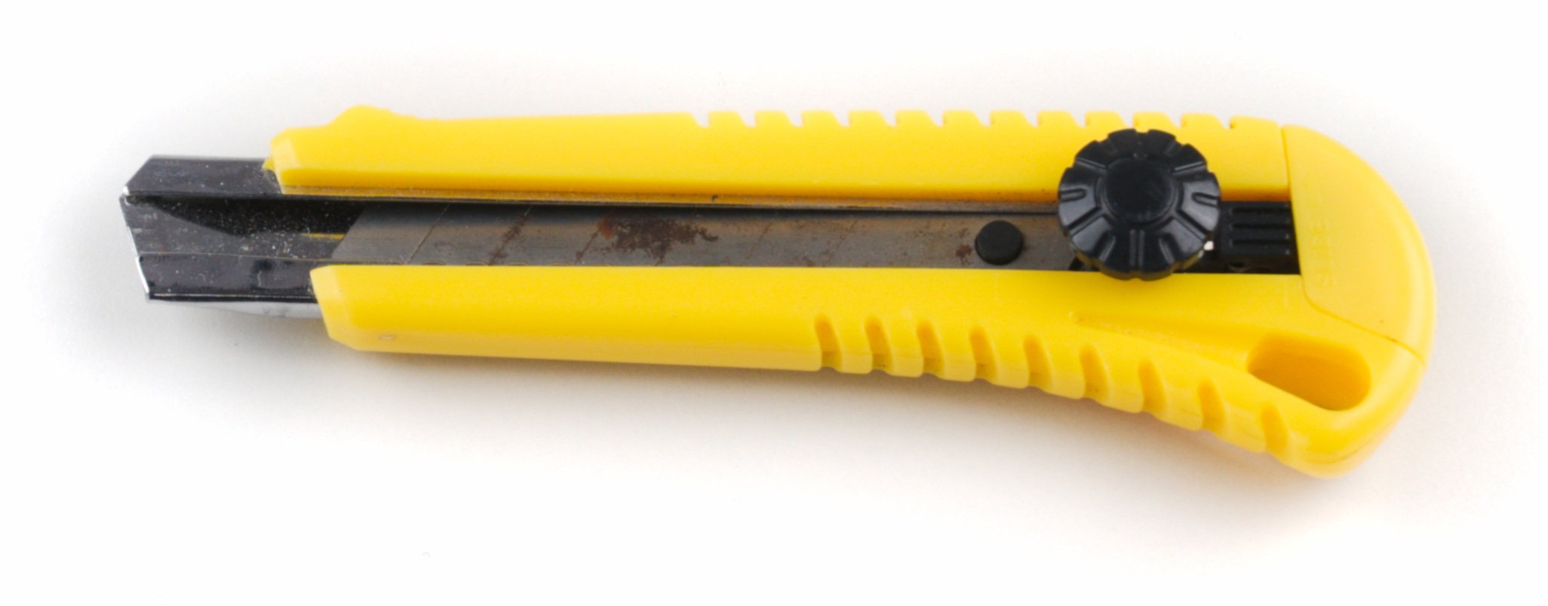
Cutter

Slide 23
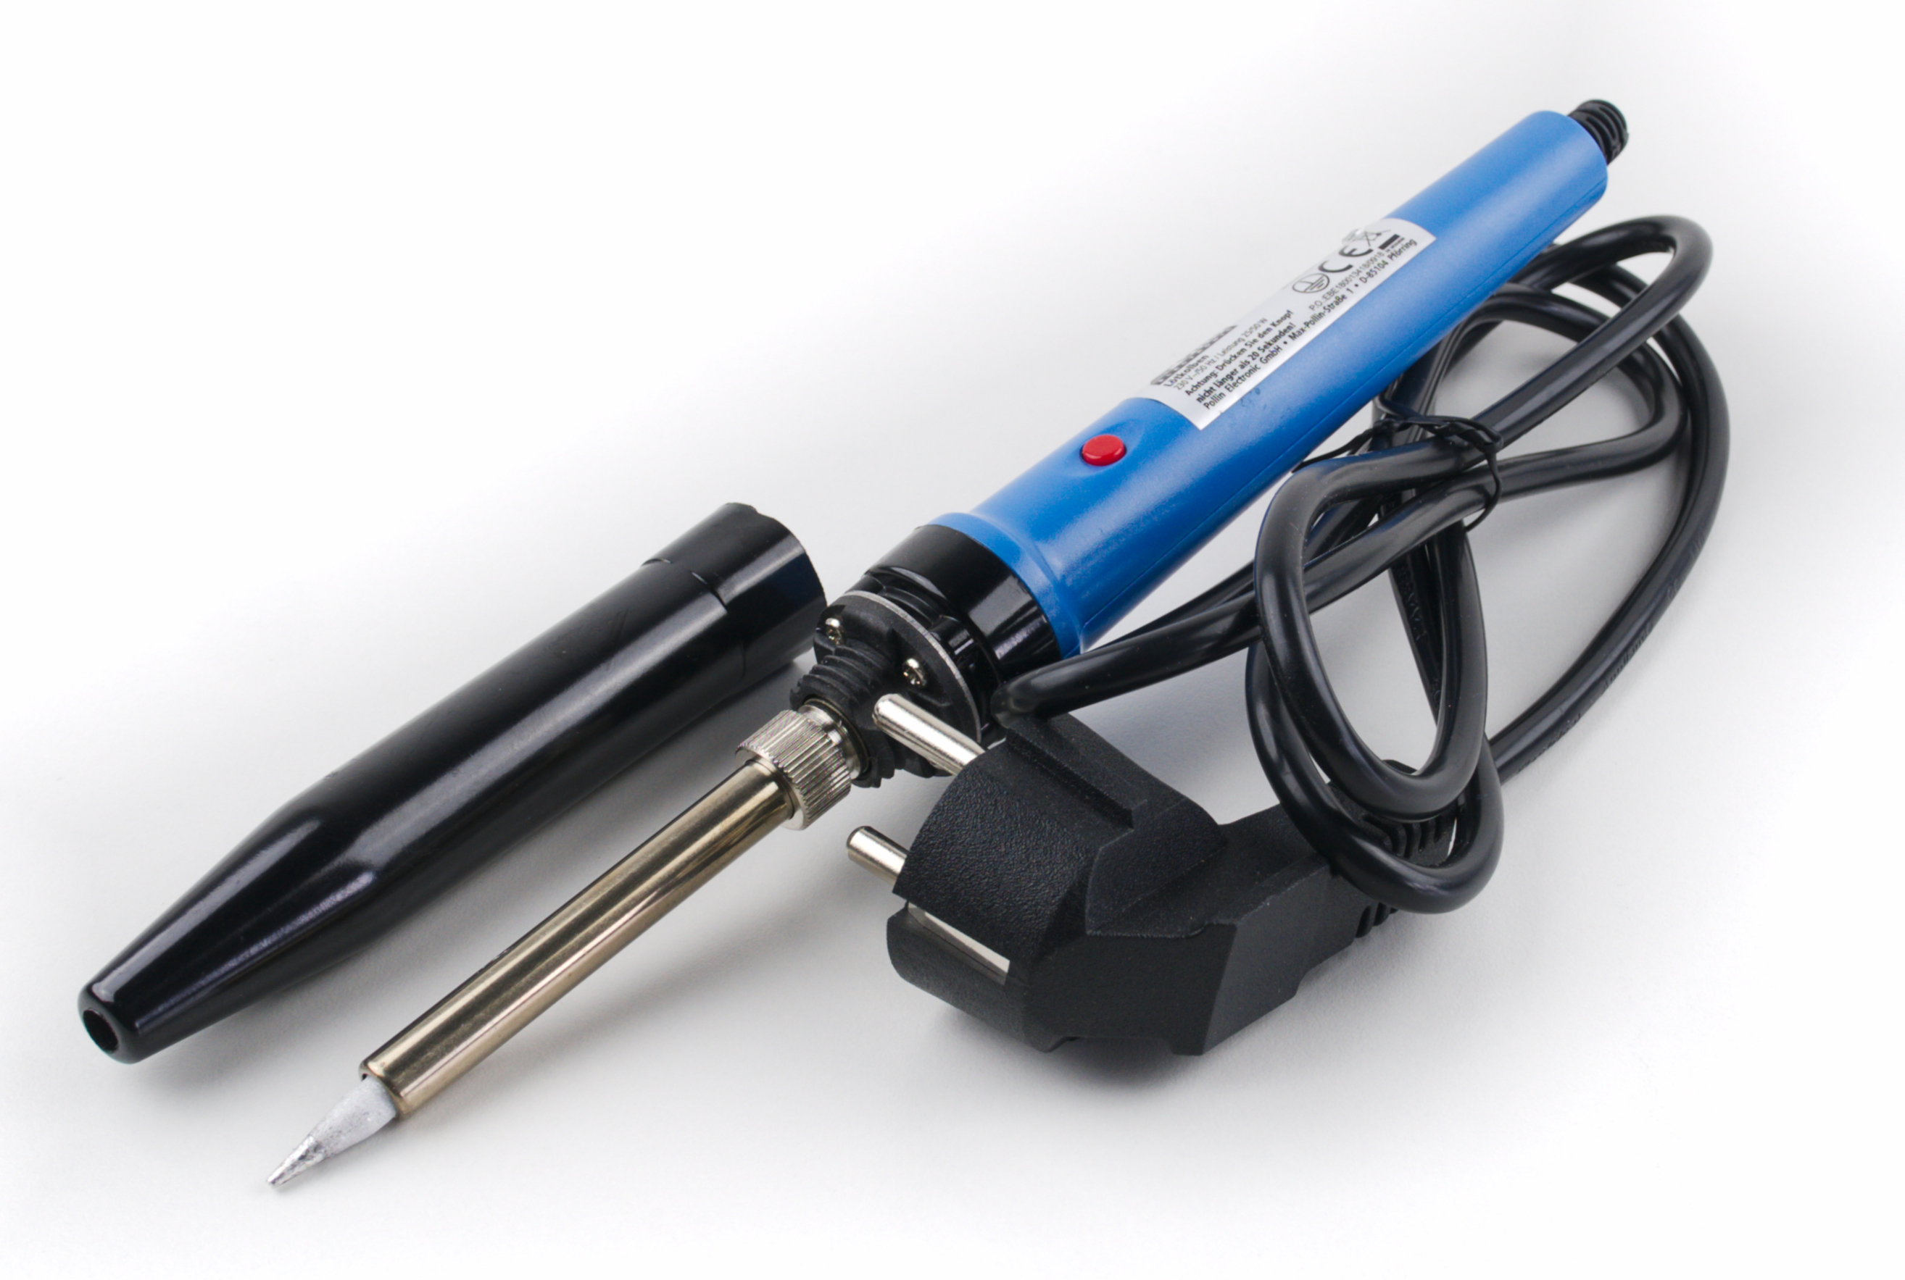
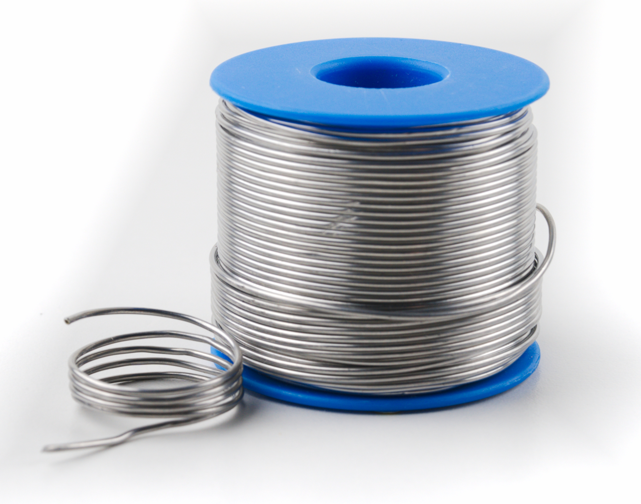
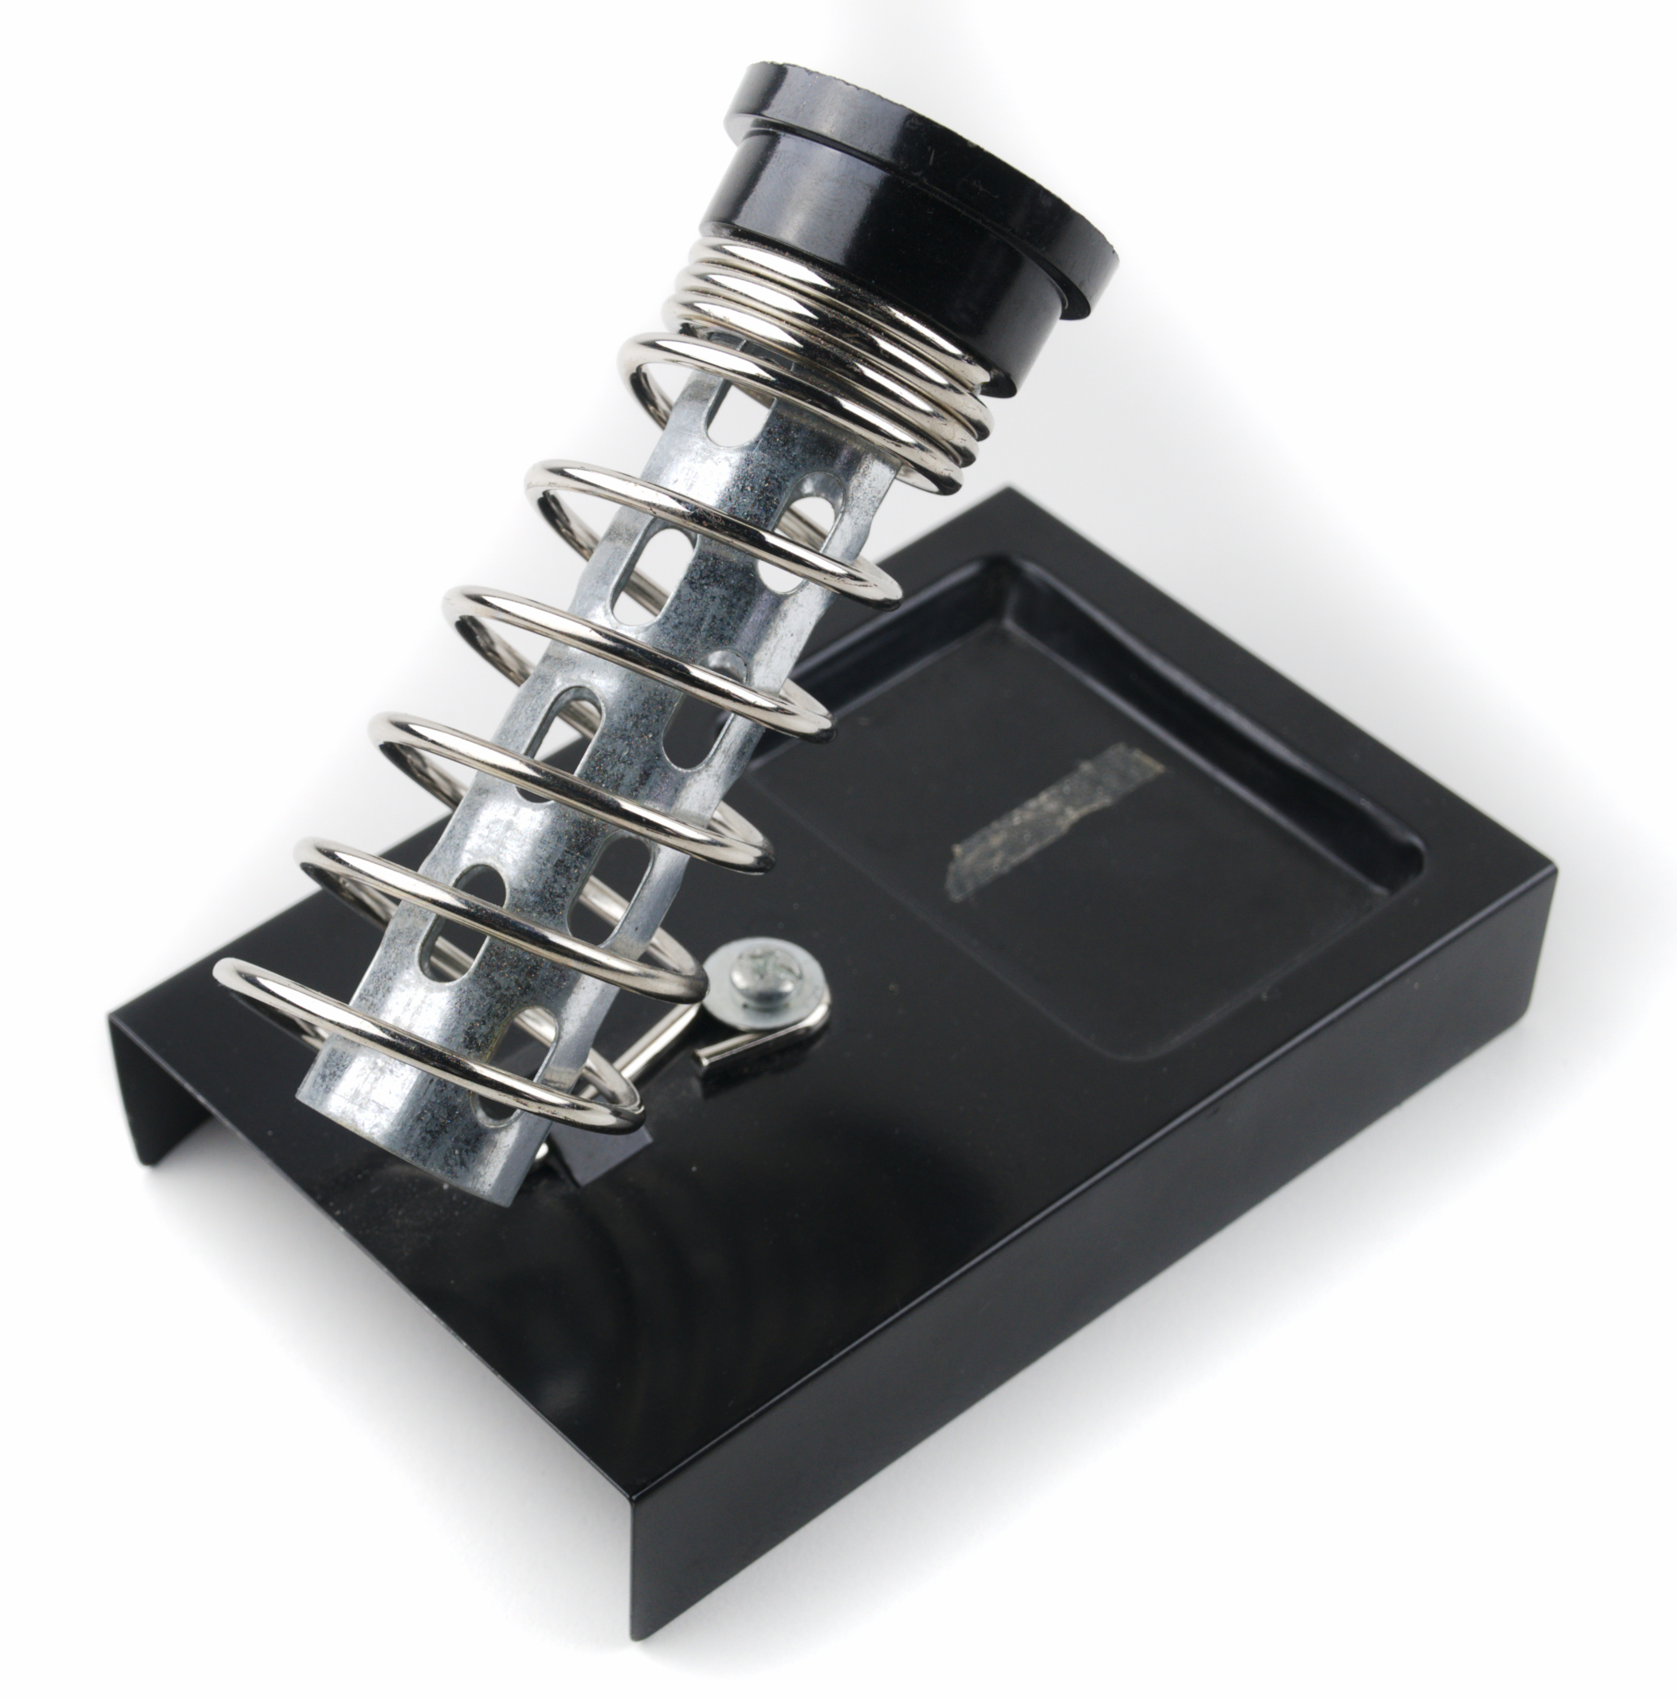


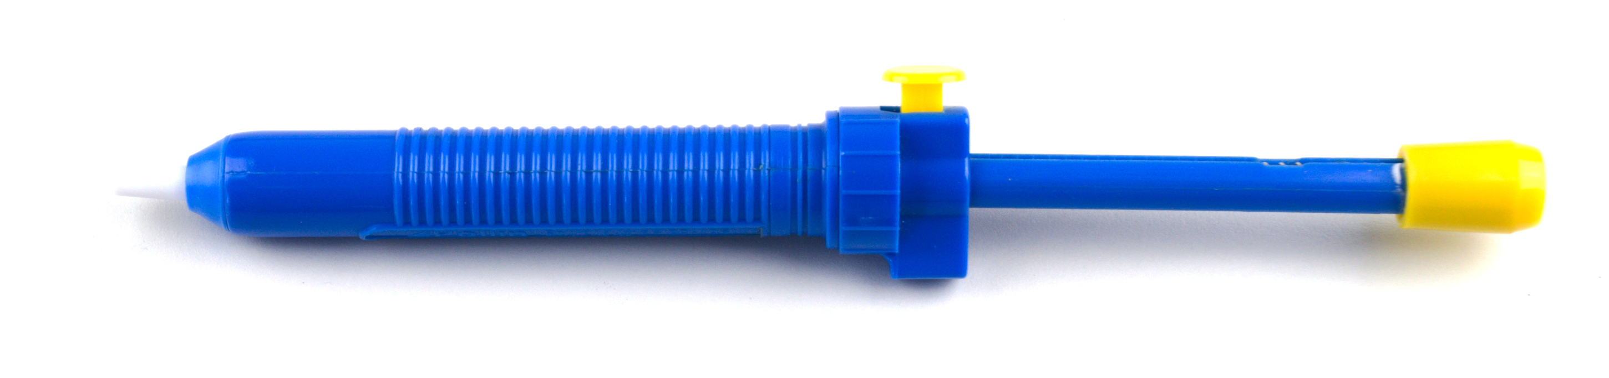
Soldering Kit
Solder
Soldering Iron Stand
Soldering Tip Cleaner
Soldering Iron
Soldering Flux
Desoldering Pump

Slide 24
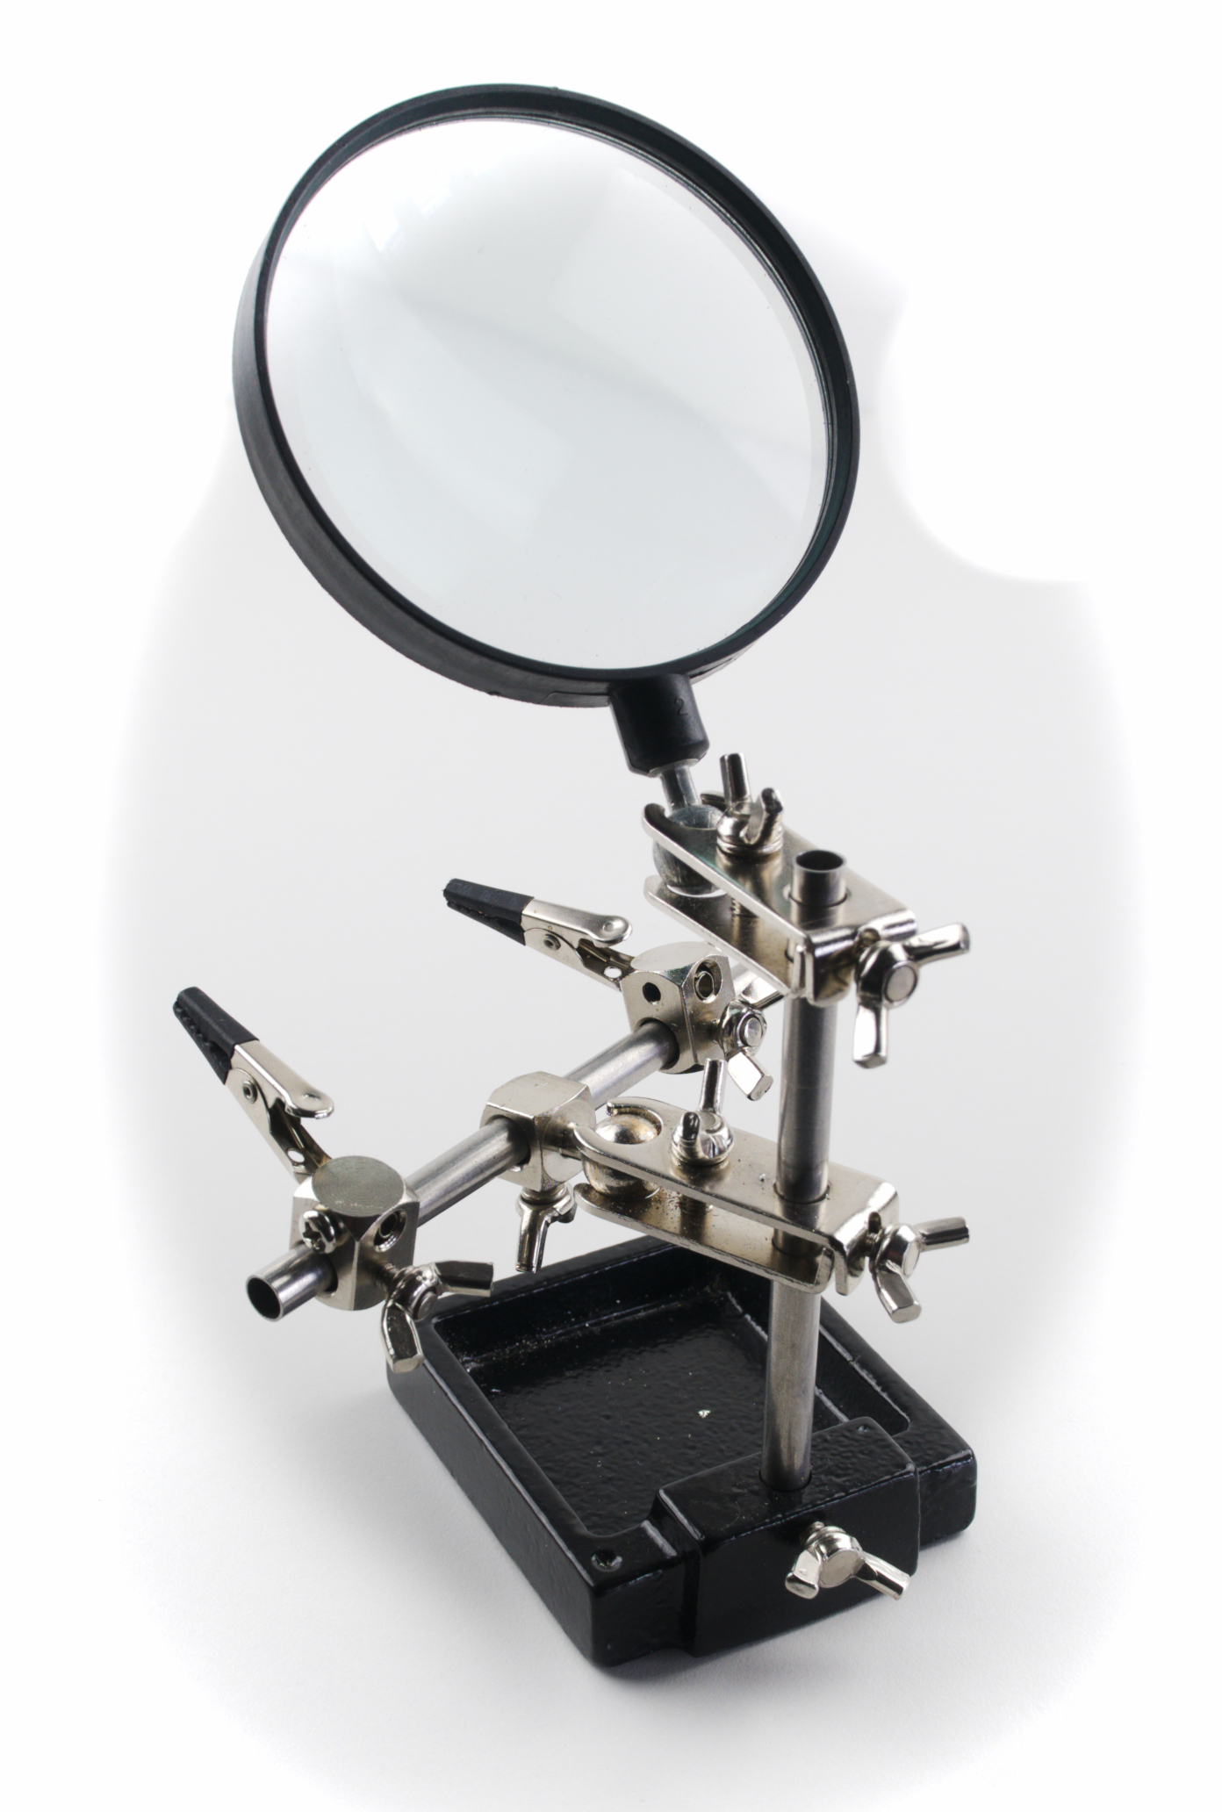
Third Hand

Slide 25
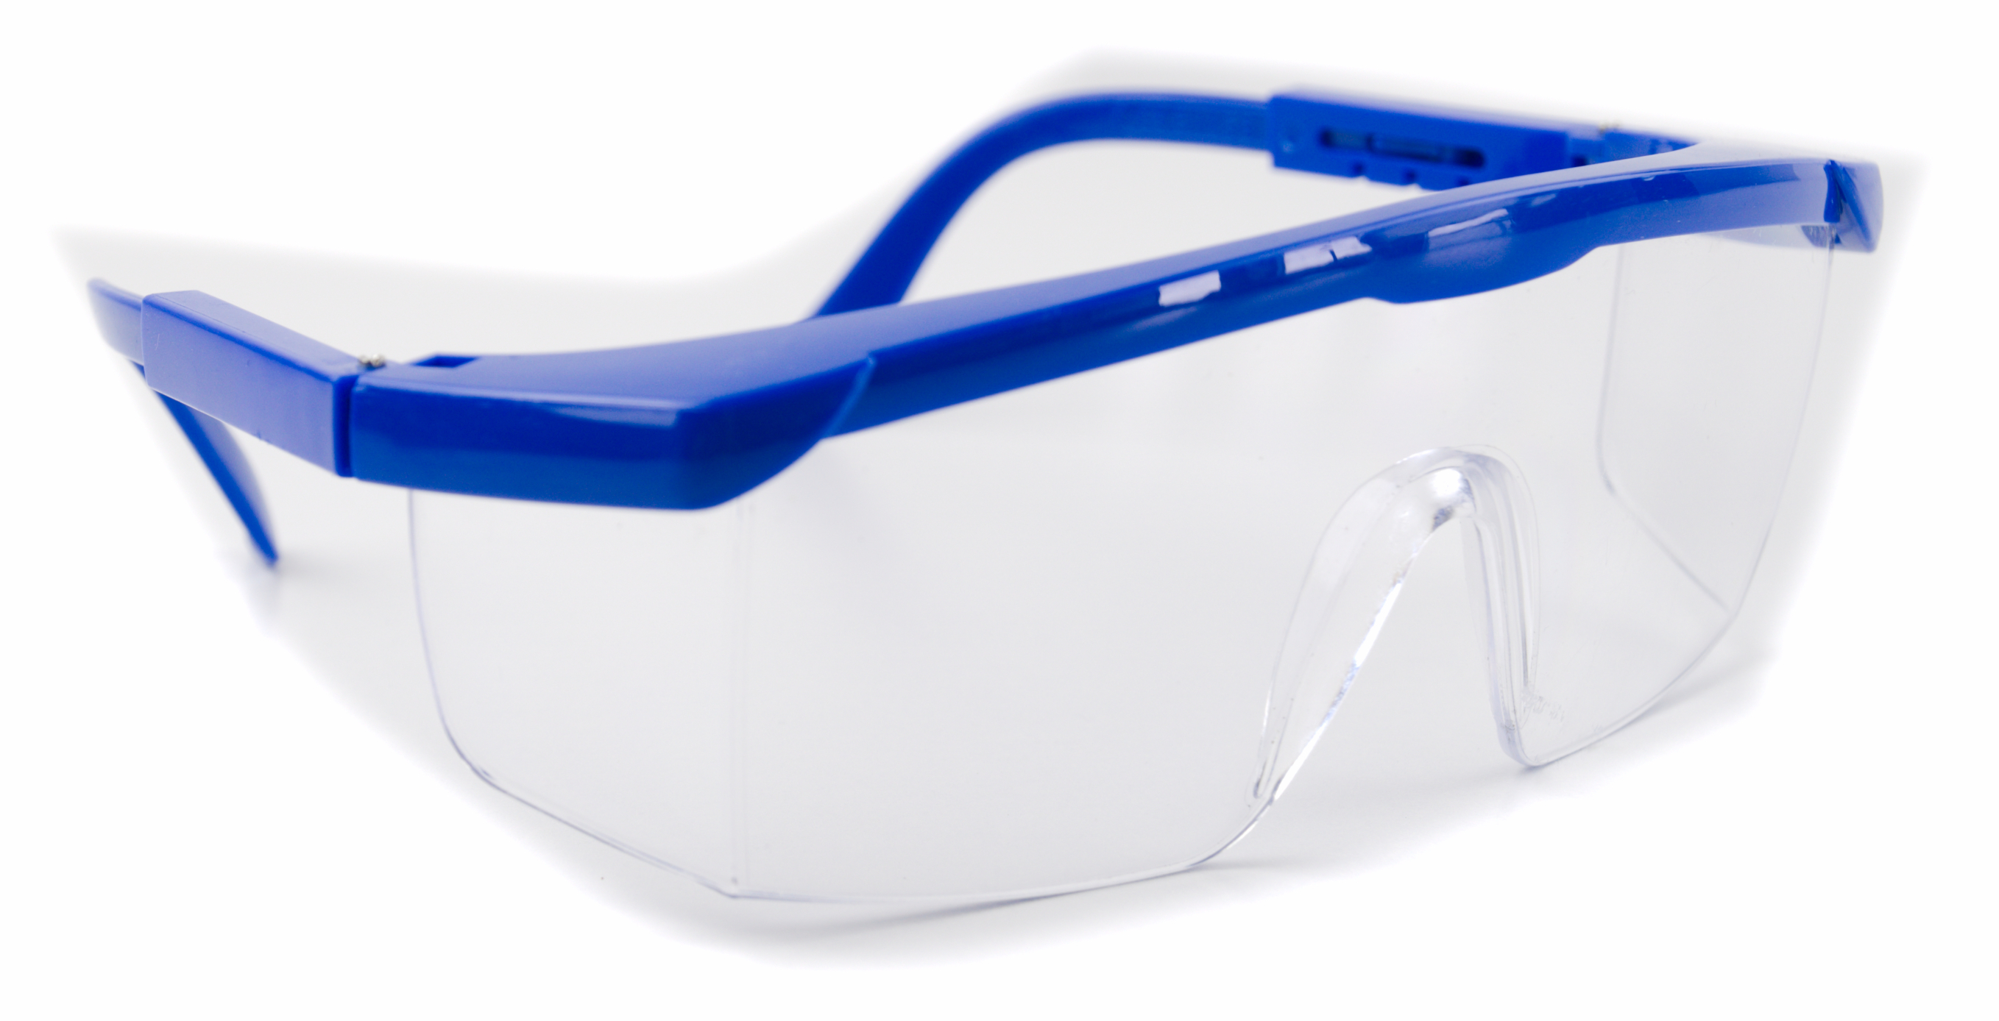
Safety Goggles

Slide 26
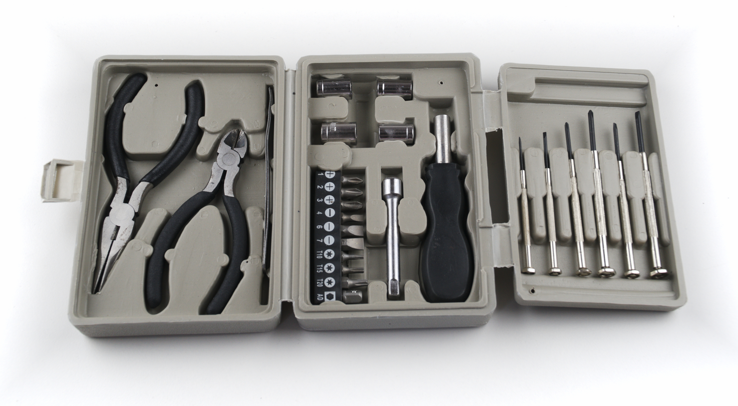
Toolbox
Nose Pliers
Wire cutter
Screwdrivers

Slide 27
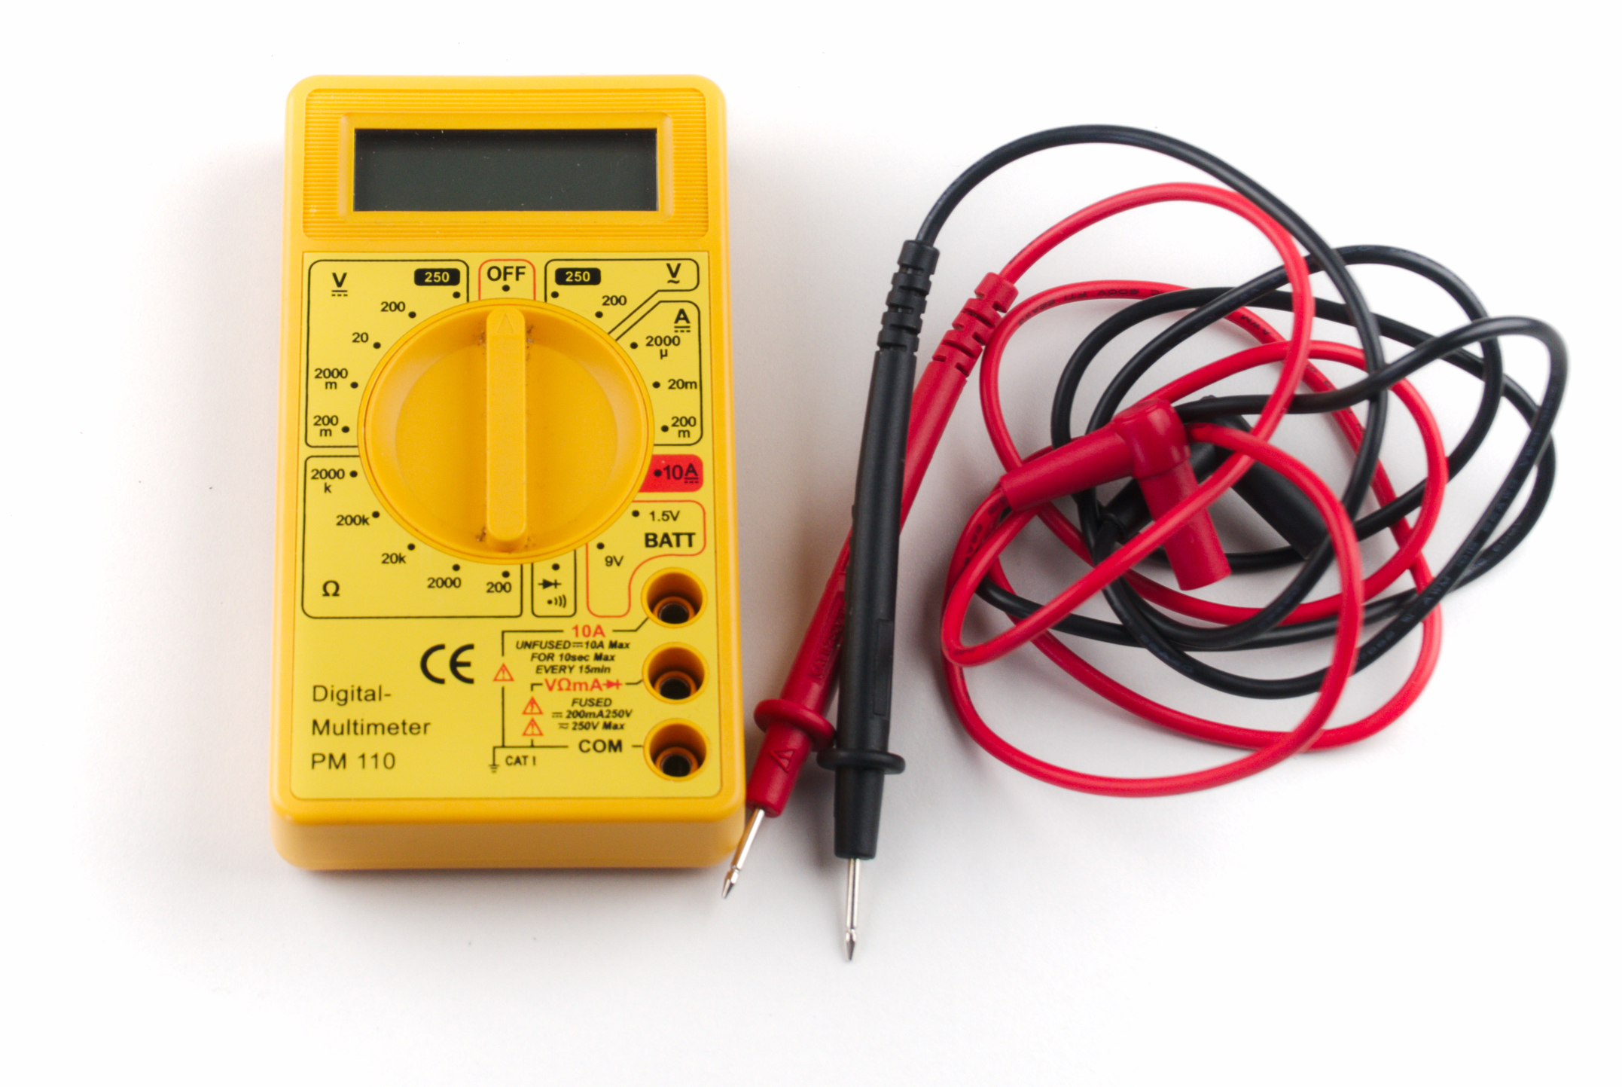
Multimeter

Slide 28
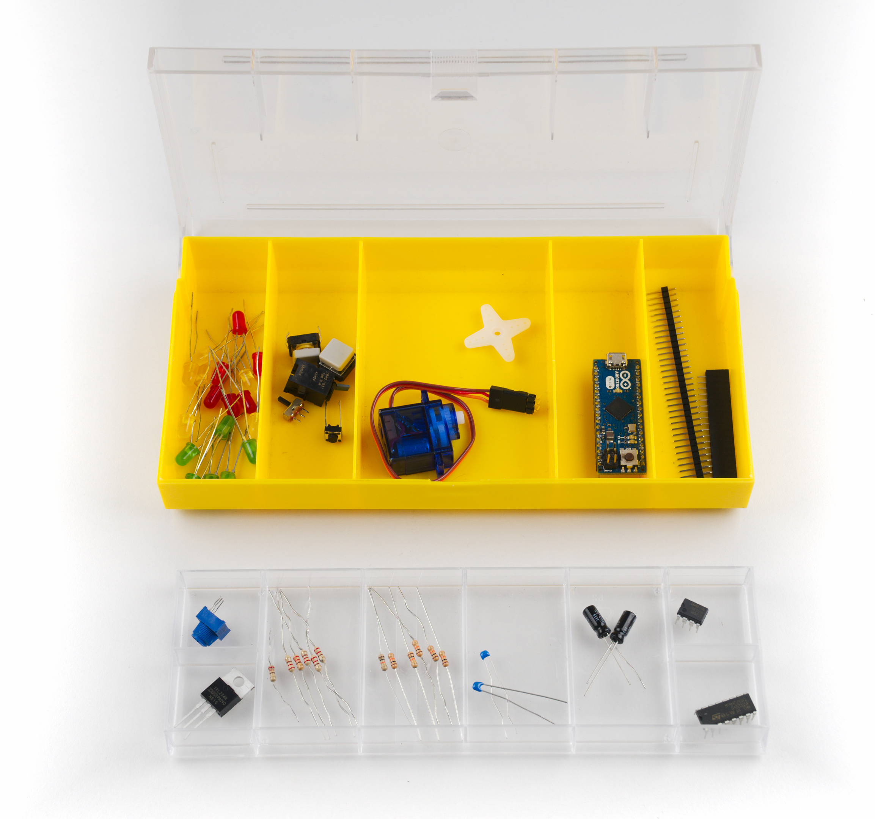
Electronic Components
Buttons & Switches
Arduino
LEDs
Servo Motor
Pin Headers
Potentiometer
Integrated Circuits
MOSFET
Resistors
Capacitors

Slide 29
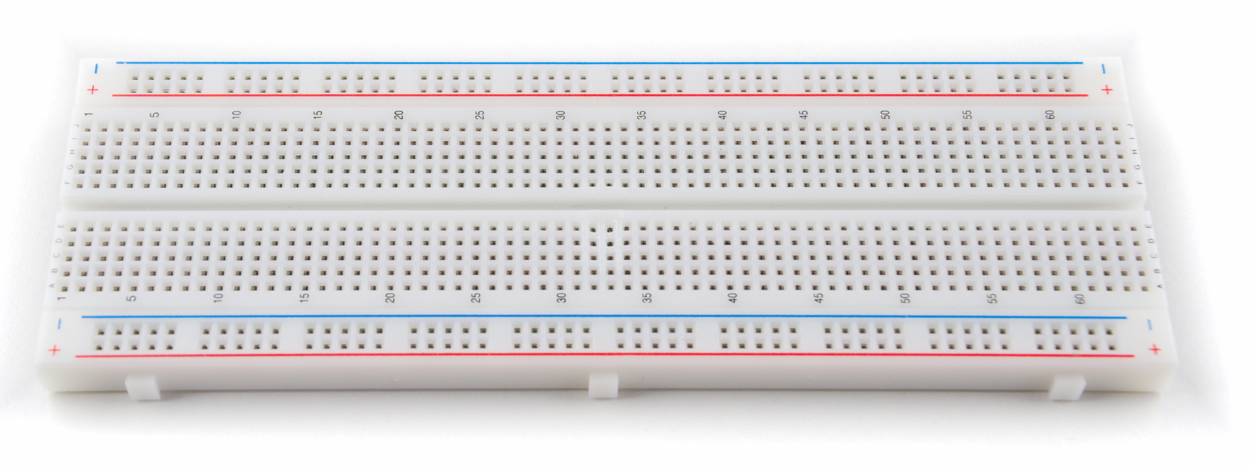
Breadboard

Slide 30
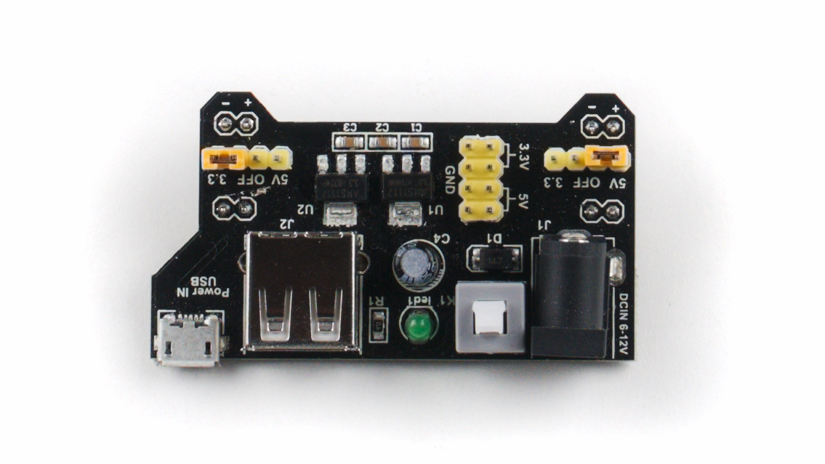
Breadboard Power Supply

Slide 31
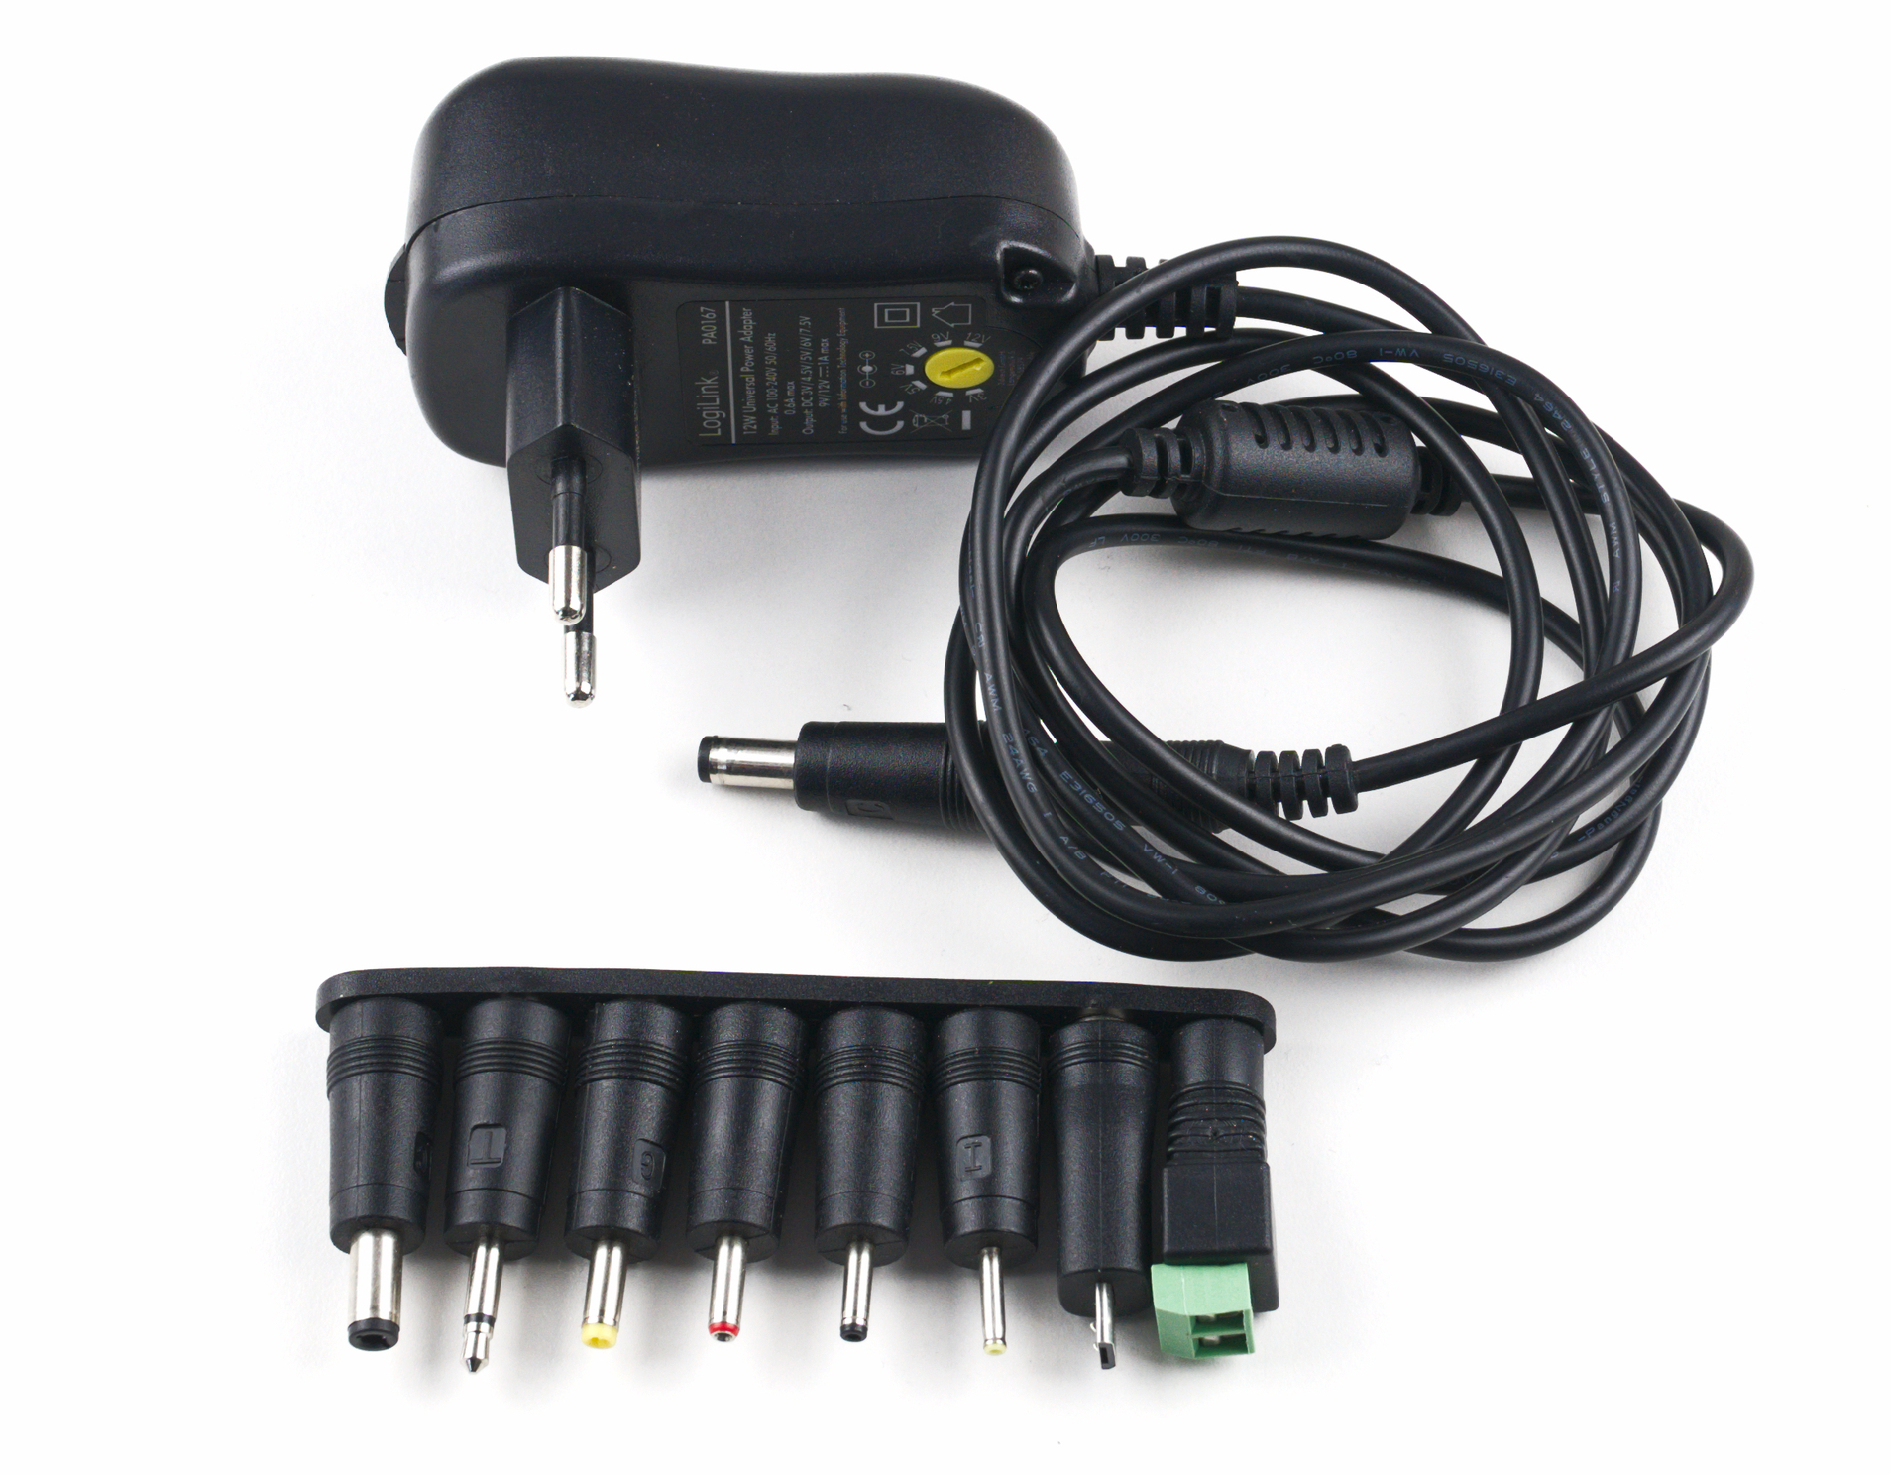
Power Supply

Slide 32
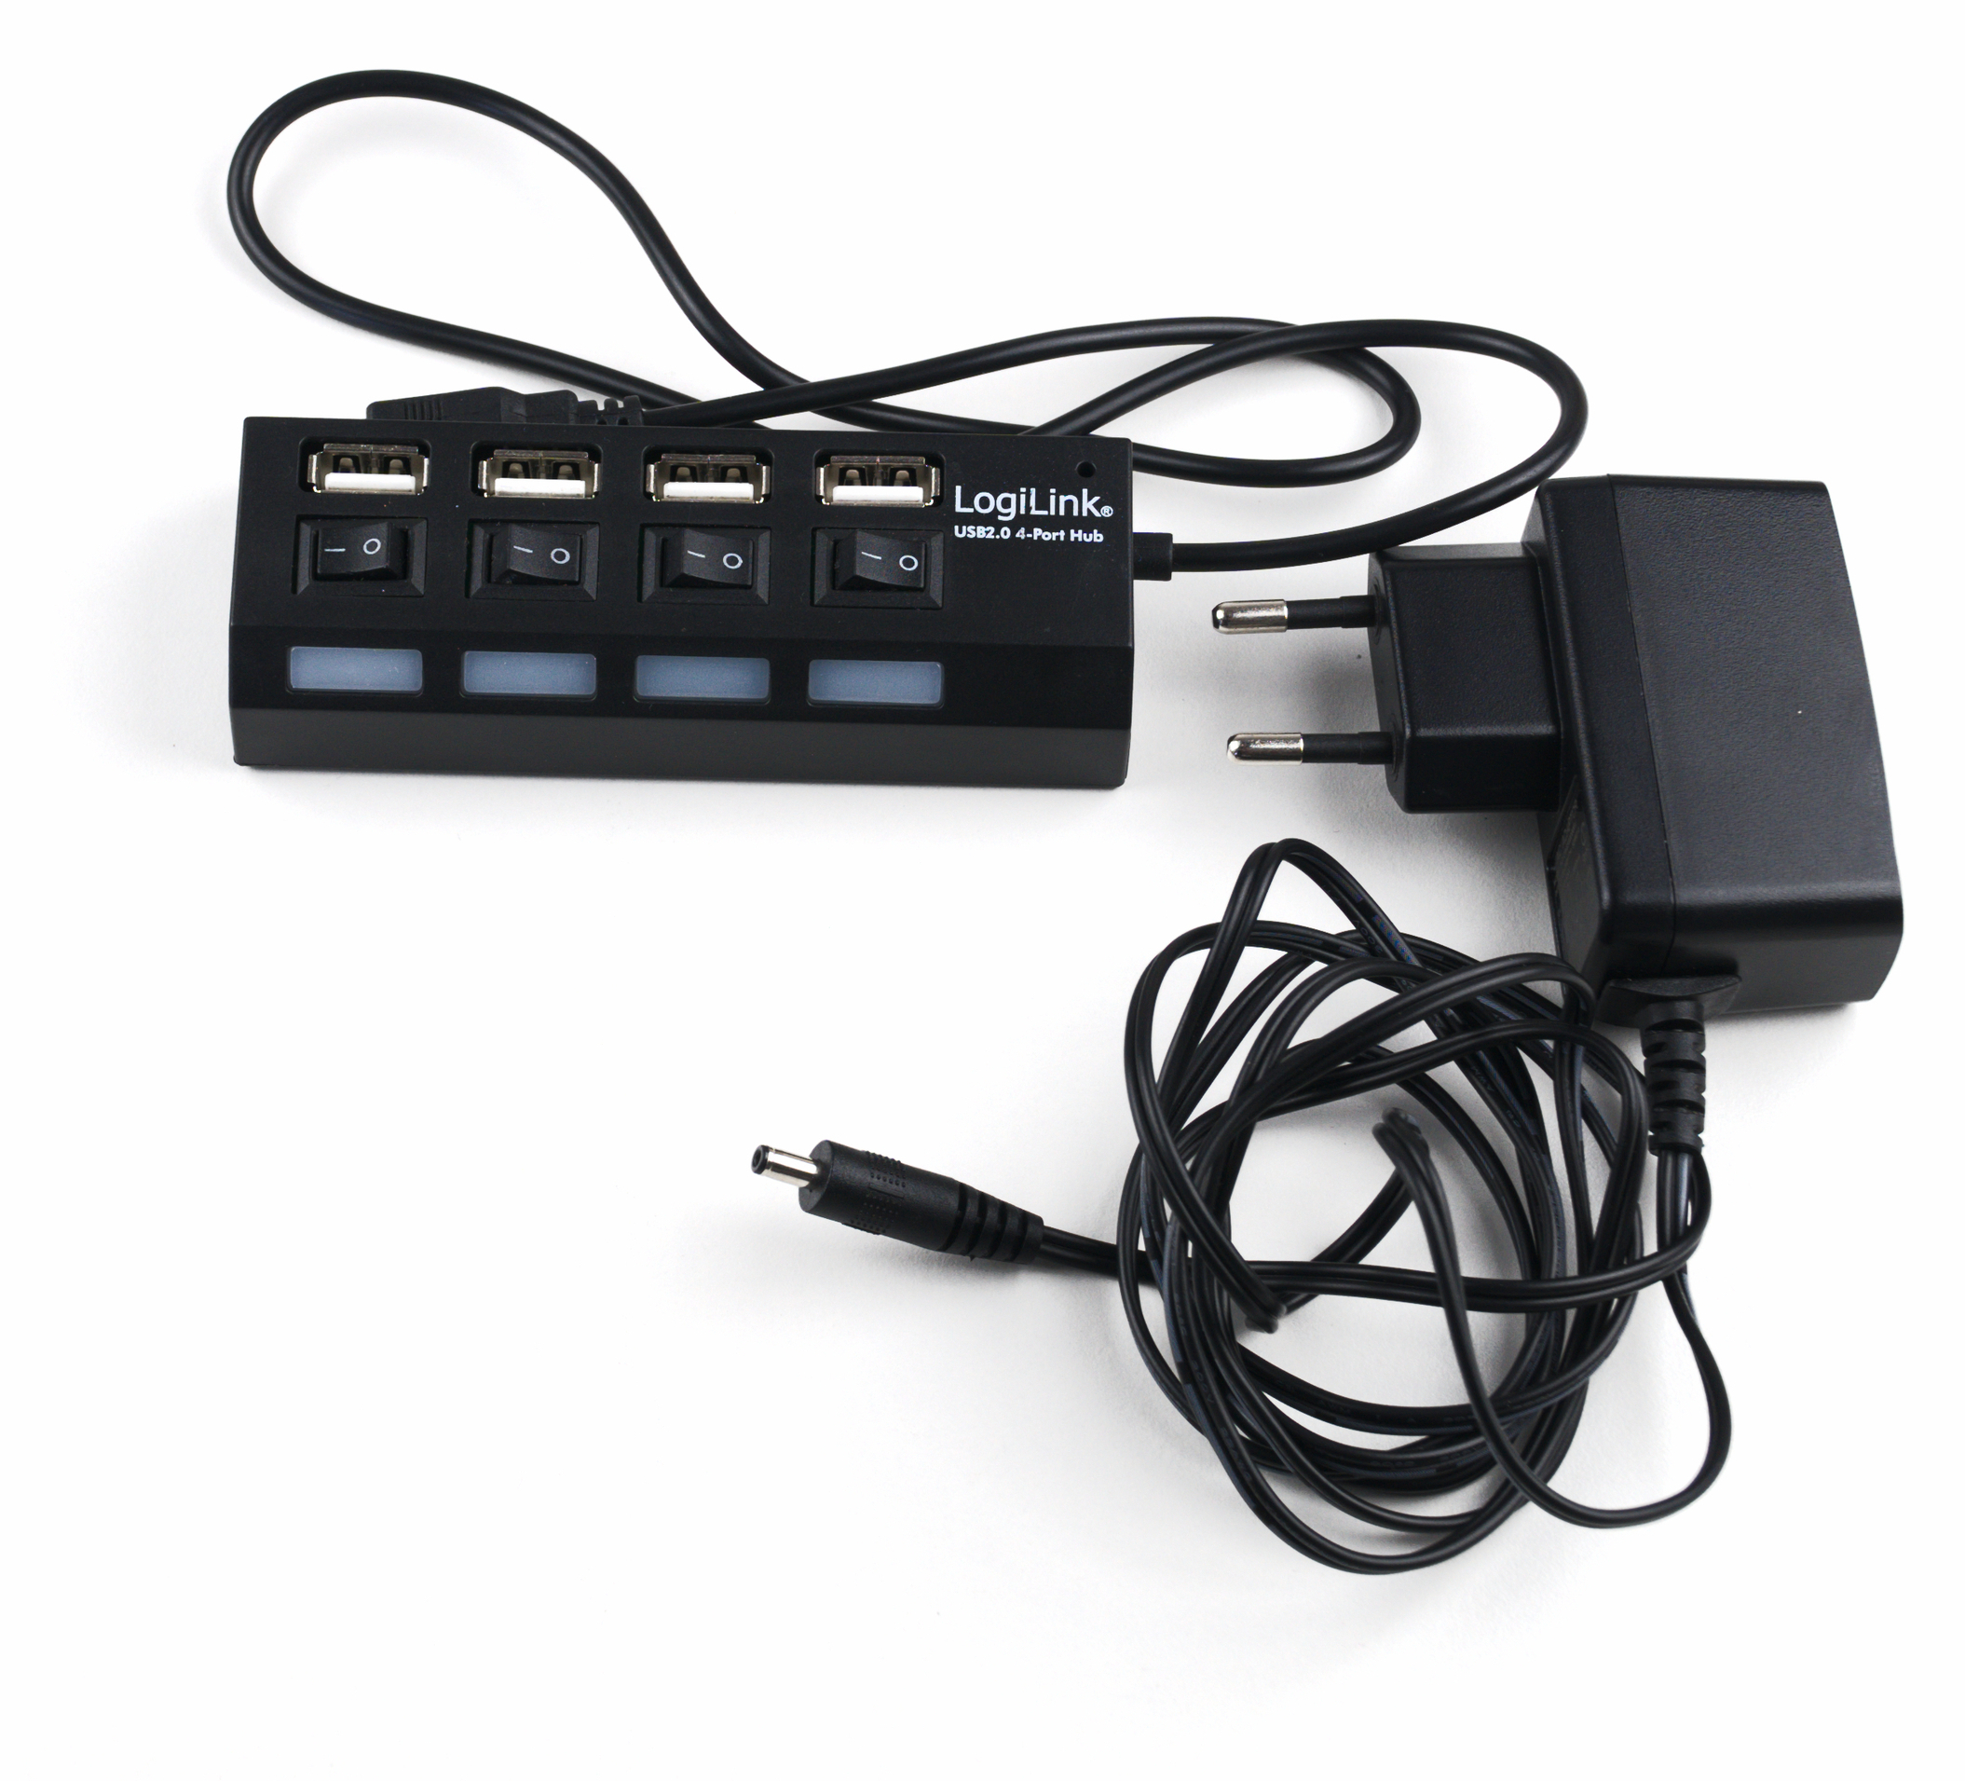
USB Hub

Slide 33
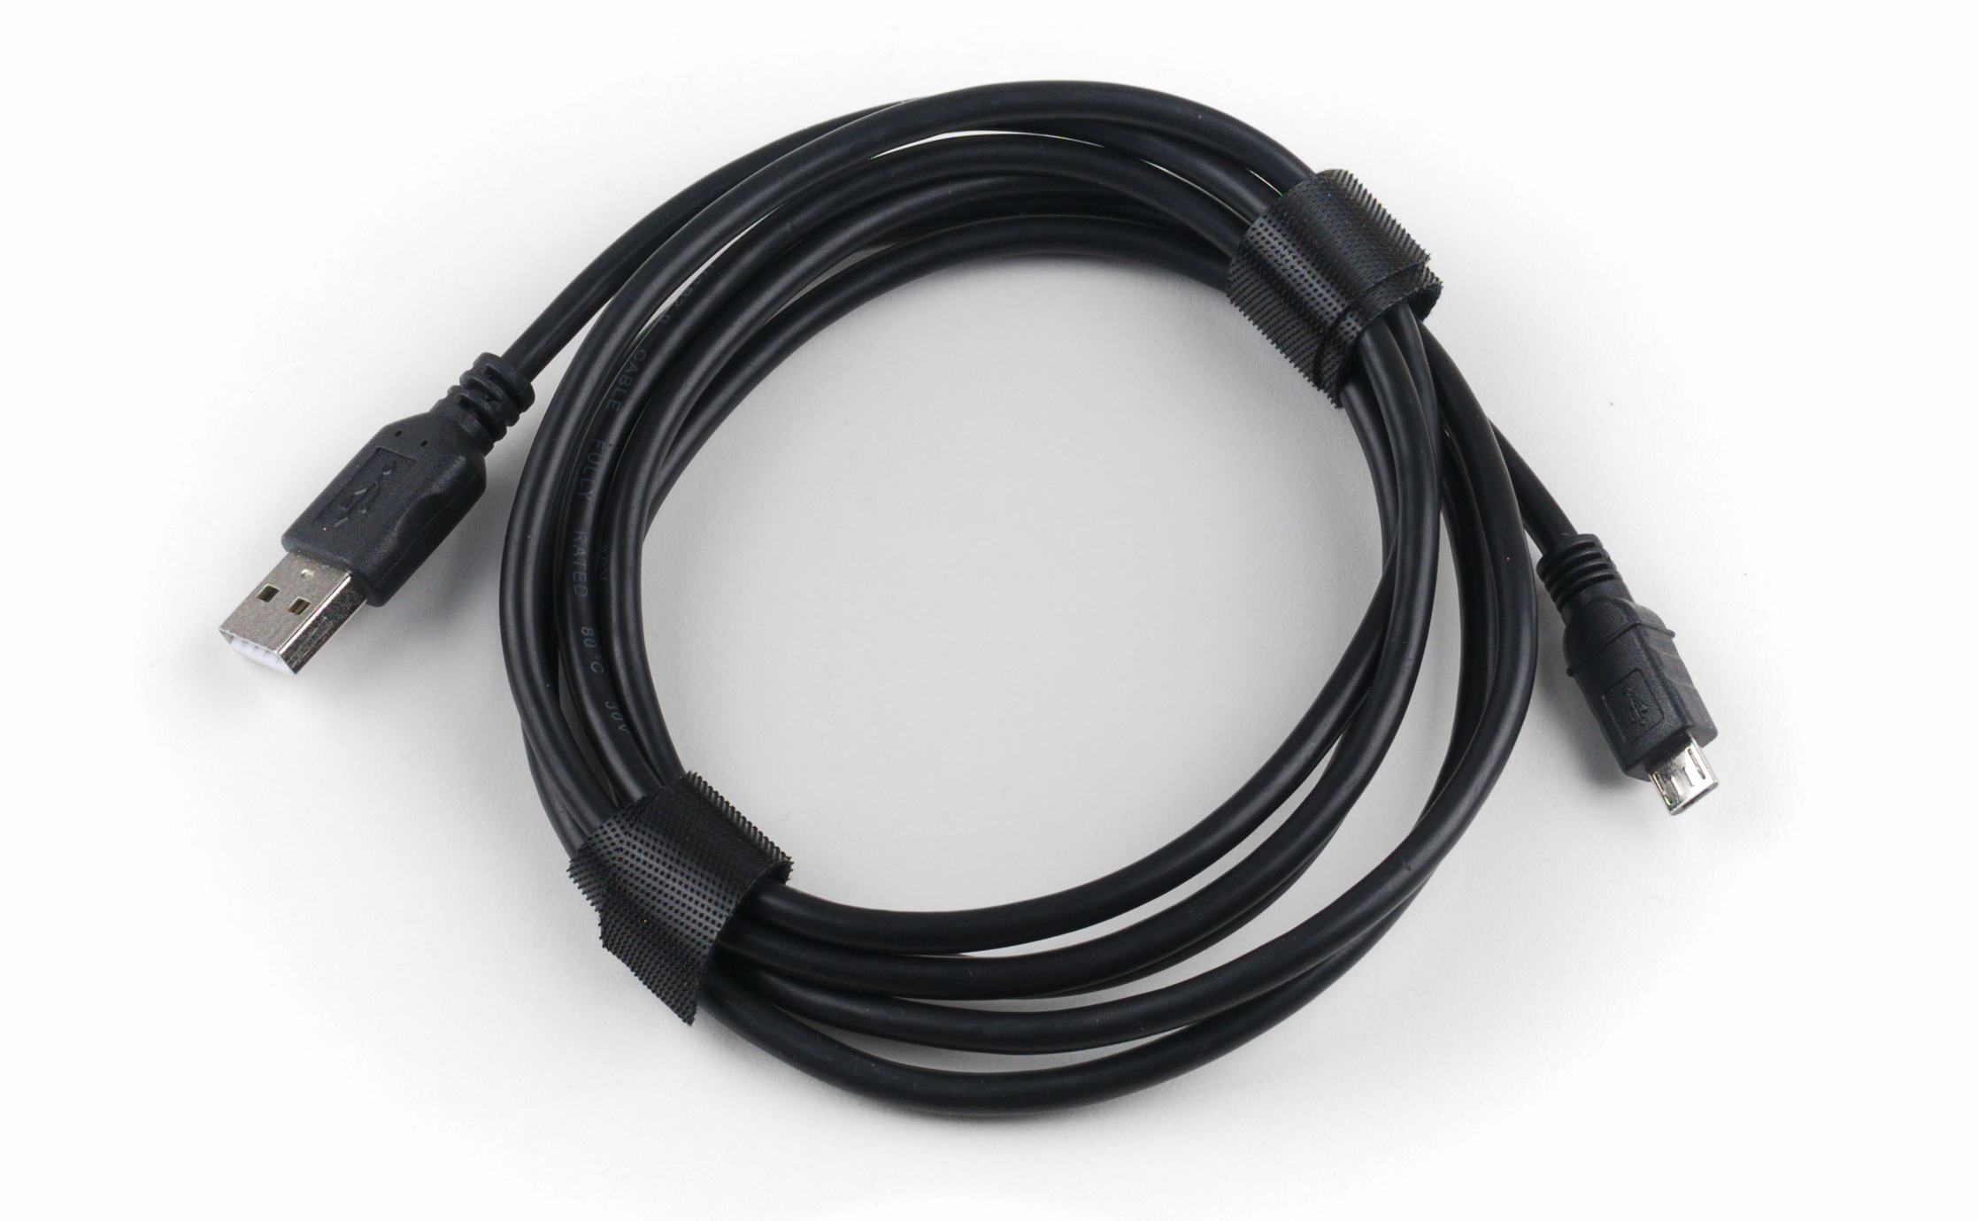
USB Cable

Slide 34
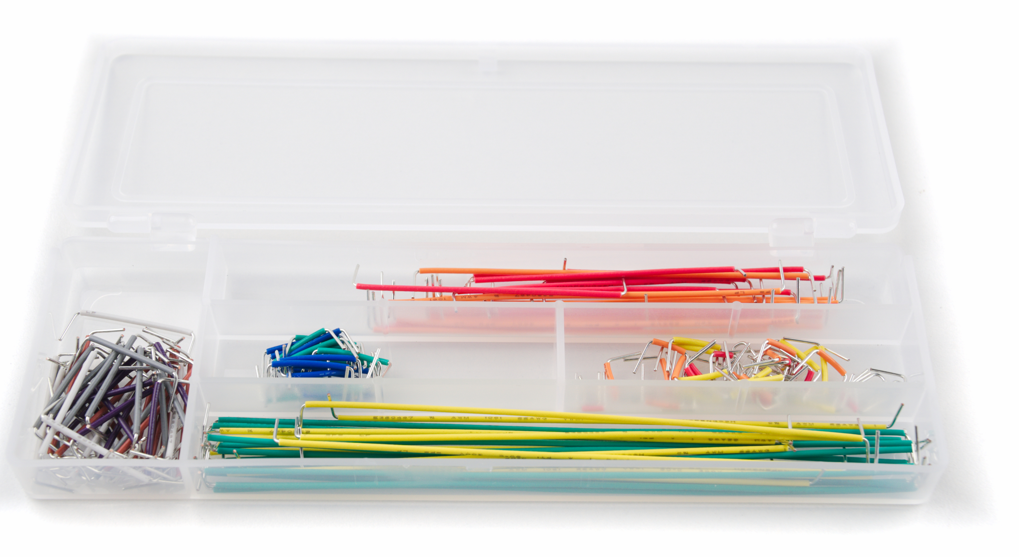
Jumper Wires

Slide 35
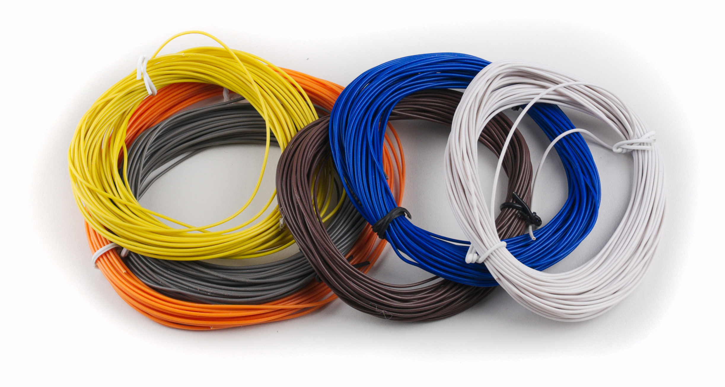
Wire

Slide 36
Short break (10 min)...

